Slide 1
Microprocessor Design

Slide 2
Introduction
Single module that performs arithmetic operations on integer values
Most arithmetic and logical operations can be done with similar hardware
Arithmetic Logic Unit (ALU)
Most important, designed first
Followed by rest of the microprocessor, feed operands and control codes to the ALU

Slide 3
Tasks of ALU
Perform basic logical operations (example: AND/OR)
Inverters allow for subtractions, NAND and NOR operations
“ALU Slices”. Each slice can perform a specific operation on a single bit. 1 slice for every bit in the operand

Slide 4
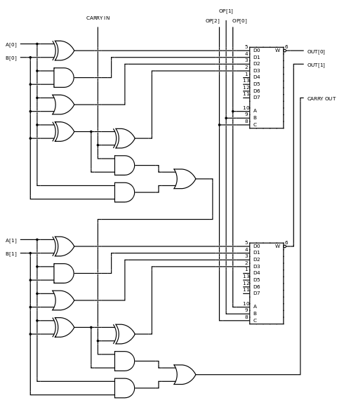
2-Bit ALU Design
Right hand side = multiplexers, used to select operands OR, AND, XOR and addition.
Operations performed in parallel
Select Signal (“OP”) decided which result to pass to the data path
Carry signal is used only for additions and needs to be ignored for other operations

Slide 5
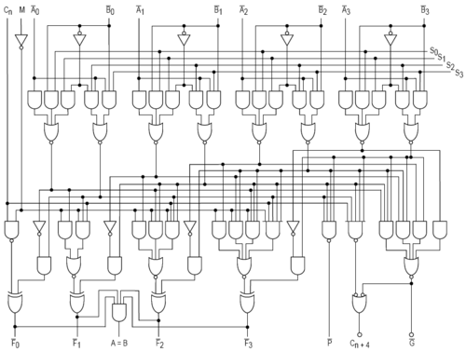
4-Bit ALU
Separate modules for multiplications and divisions
Only for integer data types (not floating- point data)
ALU an multiplies units can be used to create floating point unit (FPU) too

Slide 6
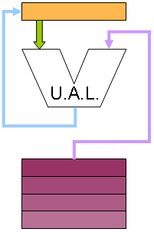
ALU Configurations
Several configurations each with various advantages and disadvantages
Each interaction set architecture (ISA), namely stack, accumulator, register-memory, register-register-load-store, requires different ways of connecting to the ALU
Orange = Memory structures internal to the CPU (registers) Purple = External Memory (RAM)
Accumulator. Stores results of every ALU operation, one of the operand to every instruction. Less complicated ISA, instructions specify one 1 operand (instead of 2) and a destination
Accumulator Architectures have simple ISAs, very fast, but requires additional software to load proper values. Difficult to pipeline.

Slide 7
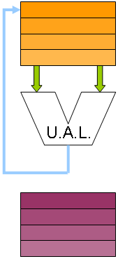
Register-to-Register
A common architectures. 3 register operand machine
Programs can specify both source operands and designation register ISA needs to be expanded
Longer instruction word length, additional effort (compared to accumulator) for write backs
Write-back step may cause synchronization issues in pipeline processor

Slide 8
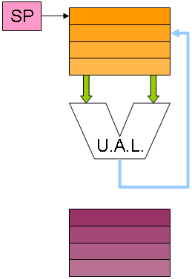
Register Stack
Combination of Register-to-Register & Accumulator structures
Operands read from the top stack and results are also pushed to the top stack
Complicated mathematical operations require decomposition into Reverse-Polish form. Difficult for programmers to use
Hardware needs to be able to implementing stack operations such as PUSH and POP operations, detect stack errors (example: popping an empty stack)

Slide 9
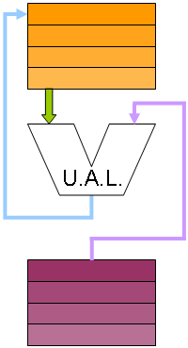
Register-and-Memory
Comparatively complicated.
1 operand from register file, other from external memory
Each instructor word needs to be store a complete memory address
Usually used along side other structures
Some CISC architecture have the option to specify one operand as a memory address. Typically specified as register address

Slide 10
Complicated structures
Some are novel. Some are a combination of above structures
IA-32
The Intel IA-32 ISA (x86 processors) use a register stack architecture for the floating point unit, but it uses a modified Register-to-Register structure for integer operations. All integer operations can specify a register as the first operand, and a register or memory location as the second operand. The first operand acts as an accumulator, so that the result is stored in the first operand register. The downside to this is that the instruction words are not uniform in length, which means that the instruction fetch and decode modules of the processor need to be very complex.
A typical IA-32 instruction is written as:
ADD AX, BX
Where AX and BX are the names of the registers. The resulting equation produces AX = AX + BX, so the result is stored back into AX.

Slide 11
Complicated Configurations continued
MIPS
MIPS uses a Register-to-Register structure. Each operation can specify two register operands, and a third destination register. The downside is that memory reads need to be made in separate operations, and the small format of the instruction words means that space is at a premium, and some tasks are difficult to perform.
An example of a MIPS instruction is:
ADD RI, R2, R3 Where R1, R2 and R3 are the names of registers. The resulting equation looks like: R1 = R2 + R3.

